Slide 1

Address Constraints to Communication
CHCCOM005 – Communicate and work in health or community service (Release 2)

Slide 2



The knowledge and skills on how to address constraints to communication are essential to maintain a collaborative relationship.
This applies not just to colleagues but to other relevant people as well.
Constraints refer to limits or restrictions that stop something from happening.
The presence of constraints hinders a smooth flow of communication.
Resolve Communication Conflicts

Slide 3

3.1
Identify Signs of Potential Conflict and Report According to Organisation Procedures

Slide 4
3.1 Identify Signs of Potential Conflict and Report According to Organisation Procedures
Before actual constraints arise, you will be observing early signs of potentially tricky situations in the service.
These early signs must be identified for them to be addressed immediately.
Reporting is essential and helps in different purposes.
Cascading such incidents to the supervisor prevents them from worsening.
The supervisor can be able to provide advice that may help both parties in resolving the situation.
Resolve Communication Conflicts

Slide 5

3.1.1 Identifying Signs of Potential Conflict
Below are some of the early signs of a potentially complicated situation:
Emotional outbursts
This refers to the sudden outpouring of the emotion of the people you are talking to.
This involves anger, overreaction or when they become hysterical.
Resolve Communication Conflicts

Slide 6
Below are some of the early signs of a potentially complicated situation:
Unusual body language
Another early sign of a potentially tricky situation is when a person displays unusual body language.
This involves their facial expressions and the way they express themselves.
Resolve Communication Conflicts

Slide 7
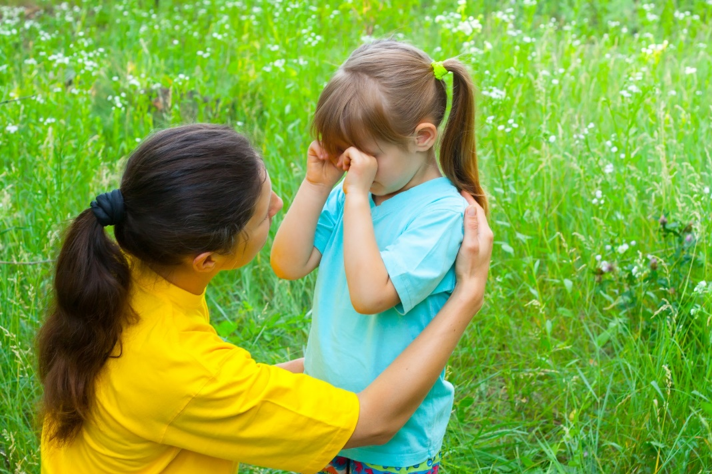
Below are some of the early signs of a potentially complicated situation:
Behavioural changes
Changes in their usual behaviour also indicate that something is not right.
This involves displaying different actions or attitude that is out of their typical character.
Resolve Communication Conflicts

Slide 8
Below are some of the early signs of a potentially complicated situation:
Choice of words
You will also notice an early sign of potential conflict based on the words that they are using.
Often, their use of words becomes emotive when they are feeling upset or disappointed.
Resolve Communication Conflicts

Slide 9
Below are some of the early signs of a potentially complicated situation:
Complaints
Another indicator is when people are raising a lot of complaints.
It can either be complaints about the service, their work role, requests or anything relevant to the service.
Complaints may either be received in face-to-face encounters or surveys conducted.
Resolve Communication Conflicts

Slide 10
3.1.2 Report According to Organisation Procedures
Early signs of potential complications or challenging situations must be addressed immediately.
Doing this will help to prevent these conflicts from arising and from worsening.
Negotiations must be done to avoid such conflicts from occurring.
If you notice a need for immediate action or assistance from appropriate people, then that is the time to consider reporting.
Reporting is one of the ways that must be done upon encountering early signs of potential conflicts in the workplace.
Resolve Communication Conflicts

Slide 11
Below are the steps to consider when reporting potential disputes:
All concerns and incidents must be reported to their supervisor for identification to control and prevent them, and attend to the potential conflicts immediately.
Signs of potentially complicated situations do not just occur within the workplace. They must be immediately reported through a phone call to the workplace supervisor.
Resolve Communication Conflicts

Slide 12

Below are the steps to consider when reporting potential disputes:
All reports must be documented using the forms and templates being used in the service, to serve as evidence or supporting documents in case actual conflicts arise within the service.
Forms and templates must be accomplished within 24 hours and must be submitted to the supervisor upon completion.
Resolve Communication Conflicts

Slide 13

3.2
Identify Communication Constraints and Resolve Using Communication Strategies and Techniques

Slide 14
3.2 Identify Communication Constraints and Resolve Using Communication Strategies and Techniques
There are many possible constraints to communication.
These constraints must be resolved for effective communication to take place.
When constraints are resolved, messages can be clearly and accurately conveyed; and the communication process becomes smooth sailing that will save time and resources.
Resolving constraints can be done by using and selecting the appropriate communication strategies and techniques.
Resolve Communication Conflicts

Slide 15

3.2.1 Identify Communication Constraints
Constraints to effective communication affect the clarity and the delivery of information.
When communication is not smooth, it might result in conflicts and disagreements.
Resolve Communication Conflicts

Slide 16
Below are some of the most common constraints to effective communication:
External noise – This refers to unnecessary sounds that interrupt effective communication. This may result in misunderstanding or misinterpretation.
Differing perceptions – Constraint arises when two or more people argue due to having varying thoughts and ideas. This may also occur when there is a need for suggestions or opinions.
Resolve Communication Conflicts

Slide 17
Below are some of the most common constraints to effective communication:
Varying abilities - Community and health services often have diverse members and employees with varying abilities, disabilities, additional needs or special needs.
Absence of non-verbal cues – Non-verbal cues are essential when conveying a message to other people, but this can be a challenge when communicating via phone calls, text messages or emails.
Cultural differences – Each person has a different culture having their personal beliefs as well as languages.
Resolve Communication Conflicts

Slide 18

Below are some of the most common constraints to effective communication:
Psychological state – Psychological states such as stress, anger and disappointment can impact communication.
Resolve Communication Conflicts

Slide 19

Below are some of the most common constraints to effective communication:
Attitude towards situations
This refers to the attitude of the people towards the problem they encounter. This involves a lack of motivation toward work or resistance to change.
A person who lacks motivation and resists change is usually close-minded and limited to their own opinions.
Resolve Communication Conflicts

Slide 20
3.2.2 Communication Strategies and Techniques
Constraints to effective communication must be resolved immediately. This is by sharing or gathering information clearly and smoothly to avoid wasting time and resources.
To address constraints to effective communication, you must consider using the following:
Communication strategies
Communication techniques
Resolve Communication Conflicts

Slide 21

Communication Strategies
Communication strategies refer to the ideas that must be considered to resolve constraints to communication.
These strategies will turn into decisions of putting everything into action.
Resolve Communication Conflicts

Slide 22
Below are some of the communication strategies that can be used to settle constraints in communication:
Focus on the information and not on the person you are talking to.
Communicate with people in a timely manner.
Be consistent with the use of positive language.
Utilise different means of communication in facilitating information.
Stay in a peaceful environment when communication with different people.
Resolve Communication Conflicts

Slide 23
Below are some of the communication strategies that can be used to settle constraints in communication:
Keep instructions clear and concise.
Broaden your knowledge and understanding of different situations.
Value and respect other people's thoughts and ideas.
Be aware with the use of non-verbal cues.
Consider inclusivity and diversity at all times.
Resolve Communication Conflicts

Slide 24

Communication Techniques
Communication techniques refer to the ways of sharing or gathering information. These require specific skills for each of them to be utilised effectively.
Each technique is appropriate for different situations to resolve constraints to effective communication.
Resolve Communication Conflicts

Slide 25
Below are some of the following communication techniques:
Open-ended questions
They refer to questions that are not answerable by ‘yes’ or ‘no’.
They require responses to explain thoughts and ideas further.
Affirmations
They refer to positive statements that can help in conquering negativities.
This helps in having a positive mindset towards different situations.
Resolve Communication Conflicts

Slide 26

Below are some of the following communication techniques:
Reflections
Reflection is done to clarify your understanding of what other people have said.
It is important to reflect for both of you to be on the same track.
Resolve Communication Conflicts

Slide 27
There are two main techniques in reflecting:
Mirroring refers to the form of reflecting wherein you exactly repeat what has been said.
Paraphrasing refers to the use of relevant words to reflect what has been said.
Resolve Communication Conflicts

Slide 28

Below are some of the following communication techniques:
Summaries
This is one of the most critical skills for effective communication.
This refers to coming up with a brief outline of the necessary points from a conversation, meetings or workplace document.
Resolve Communication Conflicts

Slide 29
Below are some of the following communication techniques:
Motivational interviewing
This refers to an approach used to help people manage uncertain feelings and insecurities.
This is done for them to be motivated in exhibiting positive behaviours.
Resolve Communication Conflicts

Slide 30
Below are some of the following communication techniques:
Coercive approach
This approach is focused on forcing an individual to change behaviour.
It does not recognise the person’s ideas and feelings, resulting in resistance and workplace conflicts.
Resolve Communication Conflicts

Slide 31

Below are some of the following communication techniques:
Collaboration
This is an approach that is concerned with both parties in a conversation.
The goal of this approach is to have a win-win solution.
Resolve Communication Conflicts

Slide 32
Below are some of the following communication techniques:
Confrontation
This refers to an approach wherein you directly tell a person your feelings, emotions and what you want to happen.
Below are example steps on how confrontation can be done:
Prepare.
Invite the person.
State the facts.
Control your emotions.
Resolve.
Resolve Communication Conflicts

Slide 33

3.3
Use Communications Skills to Avoid, Defuse and Resolve Conflict Situations

Slide 34
3.3 Use Communications Skills to Avoid, Defuse and Resolve Conflict Situations
Communication skills are one of the essential skills that you should acquire.
It would be best to communicate with relevant people in a professional manner.
It is important to use communication skills to avoid, defuse and resolve conflict scenarios.
Avoiding conflict means preventing communication issues from arising.
In cases where disputes are already present, these communication skills will help defuse or lighten the situation.
Resolve Communication Conflicts

Slide 35
The following communication skills will help in avoiding, defusing and resolving conflict situations:
Active listening
Clarity
Confidence
Empathy
Kindness
Open-mindedness
Resolve Communication Conflicts

Slide 36

What have we learnt?
In this part of the session, we have covered:
Communicate effectively with people
Collaborate with colleagues
Address constraints to communication
Report conflicts
Accomplish workplace correspondence and documentation
Contribute to continuous improvement

Slide 37
End of Chapter 3

